Slide 1
Proposed FY22-23 CIPs by Department of Corrections to State Public Works Board
August 26, 2020

Slide 2
Presenters:
Charles Daniels – Director
Ralph Wagner - Chief Engineer

Slide 3
Department Overview
The DOC has proposed 176 CIPs and 37 SWPs for FY22-23 to continue its mission of providing safety and security to the inmates and staff at 18 facilities.

Slide 4
NDOC’s Statements
Mission
The Nevada Department of Corrections will improve public safety by ensuring a safe and humane environment that incorporates proven rehabilitation initiatives that prepare individuals for successful reintegration into our communities.
Vision
Reduce victimization and recidivism by providing offenders with incentive for self-improvement and the tools to effect change.

Slide 5
Contents
NDOC’s Population Projections
10-Year Master Plan
CIPs
1 thru 19
20 thru 146
State Wide Projects (1 thru 37)

Slide 6
NDOC’s Population Projections

Slide 7
Custody Bed Capacity (Total = 13,901 as of May 14, 2020 )

Slide 8
Female Population

Slide 9
Male Population

Slide 10
10-Year Master Plan

Slide 11
Master Plan Overview
10 Year Projections to Remedy Capacity Needs
Capacity Projections by JFA Institute
Six Major Building Projects Proposed:
FMWCC - Housing Unit, Warehouse, Program Space, and Expanded Perimeter Fence
SDCC - Two Housing Units
NNCC - Two Dormitories, Housing Unit, Kitchen, Dining, Laundry, Central Plant, Warehouse, Armory, and Medical
Prison 8 – Full Build Out, Six Housing Units, Ancillary Facilities
TLVCC – Dormitory, Housing Unit, Support Bldg.
SCC – Dormitory, Support Building

Slide 12
Master Plan Bases (1 of 3)

Slide 13
Master Plan Bases (2 of 3)

Slide 14
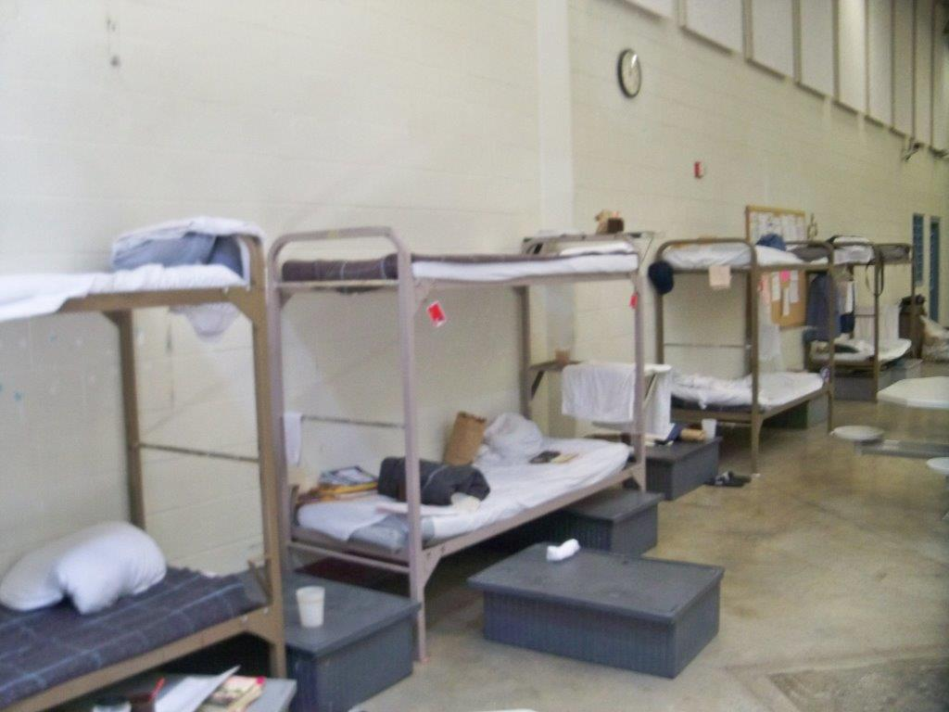
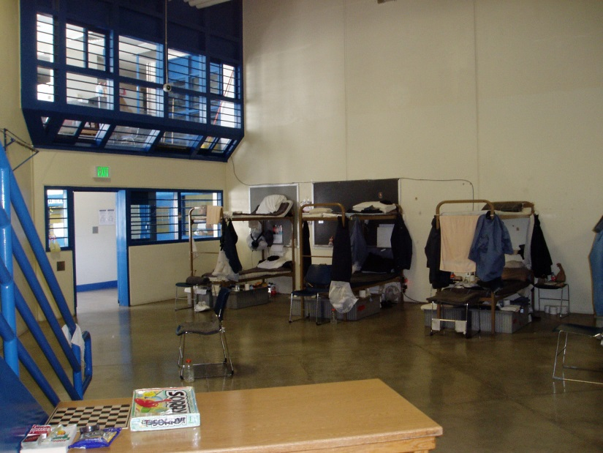
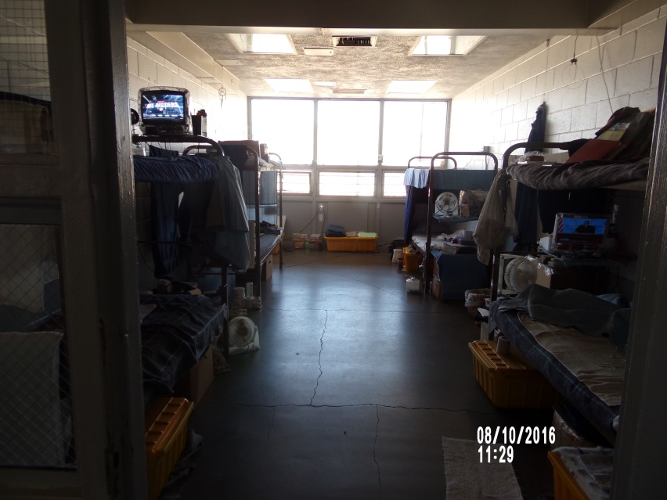
Master Plan Bases–Overcrowding (3 of 3)
FMWCC
LCC
NNCC

Slide 15
Master Plan – FMWCC Priority in March, 2020 was No. 92 but recently moved to No. 4 ($24.7M) and No. 5 ($7.4M) to reflect new dynamics

Slide 16
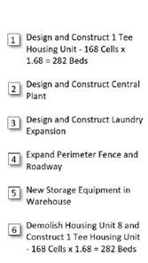
Master Plan – SDCC Priority No. 33 - $122M

Slide 17
Master Plan – NNCC Priority No. 8 – Advanced Planning - $3.6M

Slide 18
Master Plan – Prison 8 Priority No. 81 – Advanced Planning - $3.0M

Slide 19
Master Plan – TLVCC Priority No. 78 – Advanced Planning - $2.9M

Slide 20
Master Plan – SCC Priority No. 80 – Advanced Planning - $2.2M

Slide 21
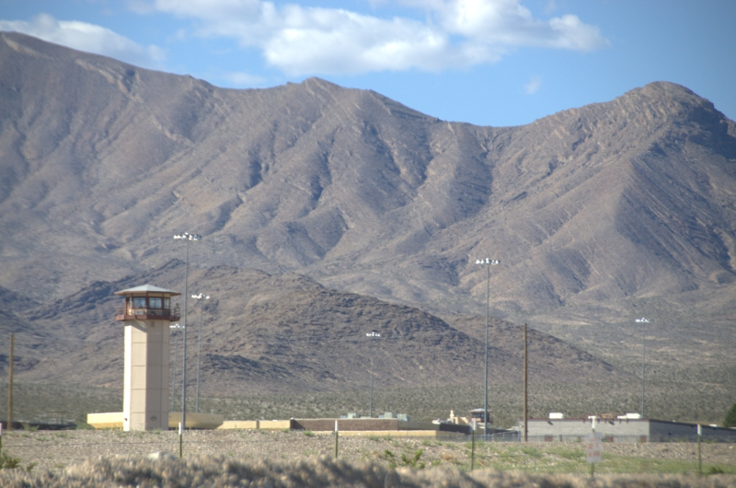
CIP Requests

Slide 22
Facility Abbreviations (1 of 2)
CCC – Carlin Conservation Camp
CGTH – Casa Grande Transitional Housing
ECC – Ely Conservation Camp
ESP – Ely State Prison
FMWCC – Florence McClure Women’s Corr. Center
HCC – Humboldt Conservation Camp
HDSP – High Desert State Prison
JCC – Jean Conservation Camp
LCC – Lovelock Conservation Camp
NNCC – Northern Nevada Correctional Center

Slide 23
Facility Abbreviations (2 of 2)
NNTH – Northern Nevada Transitional Center
NSP – Nevada Sate Prison (Closed)
PCC – Pioche Conservation Camp
SCC – Stewart Conservation Camp
SDCC – Southern Desert Correctional Center
SNCC – South. Nevada Correctional Center (Closed)
SSCC – Silver Springs Correctional Center (Closed)
TCC – Tonopah Conservation Camp
TLVCC – Three Lakes Valley Conservation Camp
WCC – Wells Conservation Camp
WSCC – Warm Springs Correctional Center

Slide 24
Personnel Abbreviations
D – Director
DD – Deputy Director
W – Warden
AW – Assistant Warden
Lt – Lieutenant
CE – Chief Engineer
FM – Facility Manager
FS – Facility Supervisor
ASO – Adm. Serv. Officer
NDOC – Nevada Department of Corrections
SPWD – State Public Works Department

Slide 25
CIP Vetting Process
W, AW, Lt, ASO, FS – Develop and Rank New CIPs for each of the 18 Facilities
CE – Merge New CIPs with Old (Non-Funded FY18-19) CIPs
CE and FM - Rank All CIPs (1 thru 176)
D and DDs – Review and Edit Ranking of All CIPs
CE – Submit 176 CIPs with Final Rankings to SPWD
SPWD – Review, Evaluate, Consolidate (as needed), and Estimate Cost of All CIPs
CE and DDs - Review and Edit SPWD Updated CIPs
SPWD – Address NDOC’s Updated CIPs and Publish Final Set of CIPs (146 Total)

Slide 26
Key CIPs (1 thru 19)
Adjusted to reflect funding shortages from COVID-19 pandemic
More focus on safety and security – less focus on efficiencies and aging
Consequently, the following 19 proposed CIPs (of an initial 176 with approximate total cost of $1B) are highlighted
Total Cost of CIPs 1 thru 19 = $115.4M

Slide 27
CIPs: 1 - 5
Facility and Description | ID No. | Cost (Million) | Ranking (A B C) |  |  |  | NDOC Priority
 |  |  | Safety | Security | Infra-Structure | Energy
ESP – Underground Piping Replacement | 21276 | $8.4 | A | A | A | A | 1
ESP - Plumbing Replacement Culinary Building | 21058 | $3.1 | A | A | B | A | 2
LCC – Upgrade Emergency Distribution System | 19276 | $1.5 | A | A | A | A | 3
FMWCC – Housing Expansion | 19346 | $24.7 | A | A | A | B | 4
FMWCC – Warehouse, Refrigeration, and Maintenance Building | 7285 | $7.4 | A | A | A | B | 5

Slide 28
CIPs: 6 - 10
Facility and Description | ID No. | Cost (Million) | Ranking (A B C) |  |  |  | NDOC Priority
 |  |  | Safety | Security | Infra-Structure | Energy
HDSP – Air Handling Unit Replacement | 7193 | $3.3 | B | A | A | A | 6
SDCC – Replace Doors, Locks, and Controls | 7290 | $17.9 | A | A | A | B | 7
NNCC - Advance Planning: Housing Unit and Core Expansion | 19344 | $3.6 | A | A | A | A | 8
NNCC - Replace Domestic Water and Sanitary Sewer | 21062 | $13.8 | B | A | A | B | 9
HDSP-SDCC-TLVCC – Natural Gas Pipeline Funding | 21060 | $8.0 | A | B | A | A | 10

Slide 29
CIPs: 11 - 15
Facility and Description | ID No. | Cost (Million) | Ranking (A B C) |  |  |  | NDOC Priority
 |  |  | Safety | Security | Infra-Structure | Energy
NNCC – Replace Locks and Controls – Housing Unit 7 | 7303 | $3.5 | A | A | A | B | 11
HDSP – Temperature Control System Replacement | 19362 | $5.3 | A | A | A | B | 12
HDSP – Dishwasher Replacement | 7106 | $0.5 | C | C | A | A | 13
NNCC – Replace Cell Doors and Locks in Housing Units 4, 5, and 6 | 21067 | $3.5 | A | A | A | B | 14
ESP – Upgrade Loading Docks | 21065 | $0.9 | B | B | A | C | 15

Slide 30
CIPs: 16 - 19
Facility and Description | ID No. | Cost (Million) | Ranking (A B C) |  |  |  | NDOC Priority
 |  |  | Safety | Security | Infra-Structure | Energy
ESP – Replace Sink, Faucet, and Water Closet Valves | 19323 | $3.4 | B | B | A | C | 16
SDCC – Replace Domestic Water Heaters | 21069 | $4.2 | B | B | A | A | 17
HDSP – Replace Finishes and Surveillance (Infirmary and Suicide Watch Rooms) | 7102 | $1.9 | A | A | C | C | 18
FMWCC – Water Softener Replacement | 21075 | $0.5 | C | C | A | B | 19

Slide 31
Remaining CIPs (20-146)

Slide 32
CIPs: 20-30
20. CGTH – Replace Surveillance System (19330) - $1.5M
21. HDSP – Continuation: Central Plant Renovation (21256) - $10.6M
SDCC – Replace Security Glazing (7291) - $1.5M
SNCC – Consolidation of Six Conservation Camps (21059) - $89.7M
HDSP – Replace High Mast Lighting (21061) - $2.8M
SSCC – Demolish Facility (21063) - $0.9M
NNCC – Electrical System Upgrade (21066) - $19.7M
WSCC – HVAC System Renovation (19340) - $0.6M
ESP – Replace Domestic and Heating Water Piping (21068) - $10.1M
SNCC – Plumbing Fixture Water Control renovation (7180) - $3.2M
ESP – Install Site Security Cameras (21070) - $1.4M

Slide 33
CIPs: 31-40
NNCC – Renovate Recreation Yard (21071) - $2.0M
SDCC – Replace Toilets and Sinks (7465) - $19.9M
SDCC – Housing Expansion (19343) - $121.6M
FMWCC – Install Sanitary Sewer Macerator (19359) - $1.0M
ESP – Upgrade Exterior Lighting (21072) - $1.0M
SDCC – Communication Room Expansion (21073) - $0.4M
SDCC – Remove Backup Generator (21074) - $0.8M
NNCC – Replace Razor wire (21076) - $0.9M
LCC – HVAC Systems Replacement (21077) - $6.9M
HDSP – Plumbing Renovation – Laundry Room (7196) - $1.4M

Slide 34
CIPs: 41-50
41. ESP – Replace High Mast Lighting (7165) - $1.7M
WSCC – Door Locks, Controls, and Renovate Doors (19288) - $1.3M
HDSP – Restore Exterior Finishes (7192) - $3.2M
SDCC – Plumbing Fixture Water Control Renovations (21106)
- $2.5M
NNCC – Tower 3 Sally Port and Office (7304) - $1.2M
ESP – Upgrade 70 Showers (21079) - $5.0M
FMWCC – Fire Rated Warehouse Doors and Window (21080)
- $0.1M
48. SDCC – New Warehouse for Dry Storage (21081) - $29.1M
HDSP – Shower Refurbishment Units (7104) - $16.1M
HDSP – Replacement of Water Controls (21082) - $7.0M

Slide 35
CIPs: 51-60
51. SDCC – Shower Refurbishment (21083) – $6.3M
52. WSCC – Replace Housing Unit 4 (19291) - $3.2M
53. WSCC – Window Replacement (19292) - $1.9M
WSCC – Install Sanitary Sewer Macerator and Headworks
(19293) - $1.1M
55. WSCC – Guard Tower (7296) – $1.8M
56. WSCC – Install Security Cameras (7141) - $3.2M
57. WSCC – Maintenance Shop (7298) - $3.0M
LCC – Culinary Flooring Replacement (7114) - $1.4M
NNCC – High Mast Lighting (7312) – $1.2M
SDCC – Advance Planning: Gun Post (7289a) - $0.1M

Slide 36
CIPs: 61-70
61. SDCC – Gymnasium Flooring Replacement (7287) - $0.8M
HDSP – Install Perimeter Shaker Fence (7163) - $4.8M
ESP – Flooring Replacement (19286) - $1.3M
FMWCC – HVAC Replacement (21084) - $8.0M
LCC – Chilled Water Plant Renovation (21085) – $2.5M
LCC – Surveillance Camera System (7083) - $5.2M
SDCC – Install Surveillance Cameras (7161) - $6.1M
NNCC – Lock Replacement (21087) - $2.6M
NNCC – Culinary Building Kitchen Ventilation System Renovation (21088) - $2.5M
FMWCC – Modify Segregation Shower Enclosures (19356) - $0.1M

Slide 37
CIPs: 71-80
SDCC – Replace Exterior Windows (21089) - $1.7M
LCC – Housing Units 1 thru 4 Plumbing Fixture Water Control Renovations (7180b) - $4.6M
LCC – High-Mast Lighting (19360) – $1.4M
LCC – Warehouse Expansion (7259) - $5.6M
FMWCC – Upgrade Intercom, Door Controls and Security Camera Systems – Phase 2 (21090) - $3.3M
LCC – Remodel Shower Enclosures (7124) – $5.6M
FMWCC – Plumbing Replacement (7283) - $1.3M
TLVCC – Advance Planning: Housing Units and Support Building (19347) - $2.9M
HDSP and SDCC – Install Rec. Yard Fencing (19373a) - $1.8M
SCC – Advance Planning: Dorm. Expansion (19345) - $2.2M

Slide 38
CIPs: 81-90
NDOC – Advance Planning Prison 8 (19348) - $3.0M
NDOC – Statewide DOC Wastewater Master Planning (21092) - $2.0M
WSCC – Advance Planning: Separation of Warm Springs and Nevada State Prison (21094) - $0.4M
NDOC – HVAC Systems Re-Commissioning (7188) - $0.4M
NDOC – Exterior Wall Insulation (7181) - $7.2M
NDOC – Replace Domestic Water Heaters (7187) - $2.5M
SCC – Surveillance Cameras (21095) - $1.0M
CGTH – HVAC Replacement (7078) – $1.4M
HCC – Exterior Lighting (7526) - $1.0M
PCC – Showers and Floor Replacement (7275) - $1.0M

Slide 39
CIPs: 91-100
NNCC – Replace Doors and Windows in HUs 4, 5, and 6 (7155) - $6.0M
NNCC – HVAC Renovation in HU 4 (21096) - $2.0M
NNCC – Replace Television Equipment (7308) - $1.9M
NNCC – Upgrade Walls n Windows in HU 7 (21097) - $2.6M
NNCC – Upgrade Walls in HUs 1-5, and 10 (7309) - $1.3M
NNCC – Design and Construct Ancillary Bldg. (7318) - $4.3M
SDCC – Advanced Planning: Wastewater System Upgrade (21101) - $1.3M
SDCC – Admin. And Gatehouse Expansion (7160) - $2.8M
SDCC – Firing Range Renovation (19325) - $1.5M
WSCC – Design and Construct Admin. Bldg. (7299) - $8.7M

Slide 40
CIPs: 101-110
SDCC – Advanced Planning: Perimeter Fence (7075) - $0.6M
WSCC – Exterior Sealing (7073) - $0.6M
WSCC – Flooring Replacement (19338) - $0.6M
WSCC – Install High Mast lighting (19334) - $0.7M
SDCC – Re-Commissioning of Mech. Systems (21104) - $1.1M
SDCC – Armory Replacement (7463) - $2.2M
SDCC – PI Building Replacement (21105) - $38.7M
SDCC – Plumbing Rework in HUs 9 thru 12 (7180c) - $5.6M
SCC – Culinary Renovation (7233) - $0.7M
SCC – Cooling System Upgrade (21107) - $0.6M

Slide 41
CIPs: 111-120
ECC – Upgrade Perimeter Fence (19310) – $1.0M
CGTH – New Gates and Controls (21198) - $0.2M
ECC – Install Perimeter Lighting (7278) - $0.6M
ECC – Shower and Restroom Renovation (7276) - $0.9M
CCC – Upgrade Perimeter Fence (7268) - $1.3M
CCC – Upgrade Emergency Generator (19302) - $1.8M
CCC – Gymnasium Improvements (7261) - $0.2M
PCC – Perimeter Fence Upgrade (19318) - $0.8M
TCC – Heating System Renovation (7232) - $0.9M
TLVCC – Upgrade Surveillance Cameras (7295) - $1.9M

Slide 42
CIPs: 121-130
TLVCC – Security Perimeter Upgrade (19373) - $4.8M
WCC – Replace Floor Structure (21109) - $1.6M
FMWCC – Plumbing Fixture Replacement (7284) - $3.8M
FMWCC – Replace Emergency Generator (21110) - $1.1M
FMWCC – Install Food Cuff Ports (7282) - $0.6M
JCC – Upgrade Showers and Plumbing (21111) - $0.5M
LCC – Wastewater System Upgrade (7273) - $4.6M
LCC – Upgrade Tank Valves and Meters (7167) - $0.3M
LCC – Digital Control System Upgrade (7118) - $1.2M
LCC – Firing Range Upgrade (19337) - $1.3M

Slide 43
CIPs: 131-140
SCC – Security Upgrade (21112) - $0.1M
SDCC – Install Perimeter Shaker Fence (7158) - $3.6M
SNCC – Toilet and Sink Replacement (19328) - $8.6M
JCC – Cell Door Locks and Controls (19321) - $2.9M
SNCC – Site Improvements (19304) - $0.1M
JCC – HVAC and Plumbing Renovation (21056) - $1.1M
JCC – Replace Emergency Generator (21053) - $0.5M
HDSP – Additional Freezer and Refrig. Storage - $0.9M
FMWCC – Upgrade Exterior Lighting (19371) - $1.2M
SCC – Upgrade Perimeter Security Fence (7237) - $0.8M

Slide 44
CIPs: 141-146
JCC – Replace Domestic Water Line (7111) - $0.6M
JCC – Install Surveillance System (19332) - $1.7M
SCC – Cable Television Infrastructure (7238) - $0.6M
WSCC – HUs 1 and 2 Restroom Remodel (7297) - $3.3M
ECC – Hazardous Storage Facility (7560) - $0.1M
ESP – Replace Sidewalks (7084) $1.0M

Slide 45
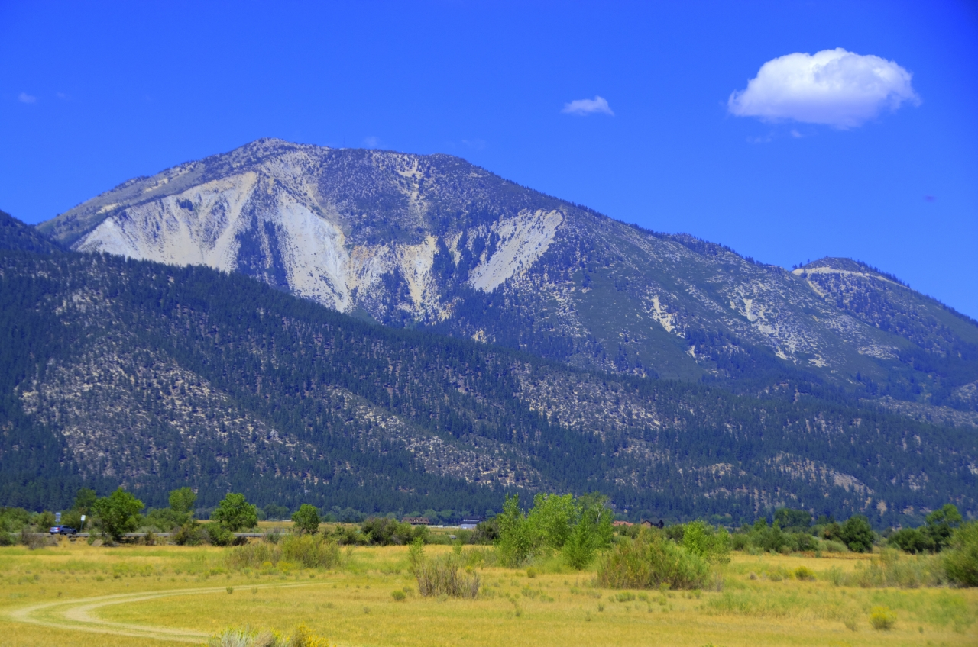
Statewide Projects (SWPs) (Proposed Projects Are Ranked From 1 to 37)

Slide 46
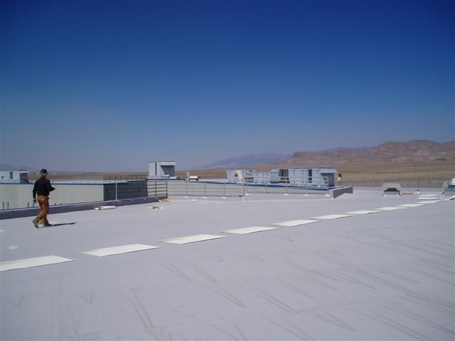
SWPs - Roofing

Slide 47
SWPs – Roofing
HDSP – Phase 1, 2, and 3 Roofs (new) – Rank 1
LCC – Infirmary, Education, Building 2, Gym, and Culinary (7708) – Rank 6
NNCC – Culinary and Dining (7315) – Rank 5
SCC – Housing Units 1 thru 5 (7238) – Rank 29
SDCC – Housing Units and Towers (7162) – Rank 7
SDCC – Gym and Gun Posts (7286) – Rank 8
WSCC – Housing Units 2 and 4 (7110) – Rank 14
WSCC – Housing Unit 1, Admin., and Gatehouse (19363) – Rank 17
NNCC – Housing Units 1 thru 4 and Warehouse (19364) – Rank 16
SCC – Evaluate All Buildings (19365) – Rank 34
SCC – Gym and NDF (19366) – Rank 35
WCC – All Buildings (new) – Rank 36

Slide 48
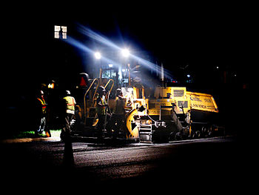
SWPs - Paving

Slide 49
SWPs – Paving (1 of 2)
FMWCC – Parking Lot and Perimeter Rd (new) – Rank 25
ECC – Parking Lot and Drive (7089 and 7578) – Rank 30
ESP – Parking Lot and Perimeter Road (7279) – Rank 9
HDSP – Slurry or Pave 504,000 SF (new) – Rank 15
HDSP – Add ADA Parking (7101) – Rank 10
HDSP – Pave West Perimeter Road (7101) – Rank 13
TCC – Parking Lot and Drive (7103 and 7532) – Rank 31
JCC – All Areas (7170 and 7127) – Rank 37
HCC – All Areas (7128) – Rank 27
NNCC – Main and Perimeter Roads (7313) – Rank 11

Slide 50
SWPs – Paving (2 of 2)
PCC – Parking Lot, Driveway, and Add ADA Parking (7087 and 7531) – Rank 28
SDCC – Perimeter Road (7292) – Rank 22
TLVCC – Employee Parking Lot (7464) – Rank 23
WCC - Parking Lot, Driveway, and Add ADA Parking (7088 and 7538) - Rank 33
WSCC – Expansion of Parking Lot (7143) – Rank 24
FMWCC – Parking Lot and Perimeter Rd (19368) – Rank 26
ESP – Sidewalks and Hardscapes Surfaces (7084) – Rank 13

Slide 51
ADA and Fire/Safety

Slide 52
SWPs – ADA and Fire/Safety
WSCC – Construct ADA Restrm (7301 and 7207) – Rank 4
WSCC – Construct ADA Showers and Toilets (7301) – Rank 32
ECC – Construct Hazard Storage Facility (7560) – Rank 18
ECC – Install Fire Sprinkler System (7277) – Rank 19
ESP - Replace Fire Alarm System (19370) – Rank 2
SDCC - Replace Fire Alarm System (7466) – Rank 3
WCC - Install Fire Sprinkler System (7255) – Rank 20
SNCC - Replace Fire Alarm System (19369) – Rank 21

Slide 53
Closing Remarks

